Slide 1
MEDICAL INSURANCE FORECASTING
Bargavi Kongara, MSBA, Clark University
Shailja Sharma , MSBA, Clark University
Srivalli Adigarla , MSBA, Clark University
Prakhar Kumar Ahuja , MSBA, Clark University

Slide 2
Business Analytics Problem
Estimate the yearly Premiums.
Difficulty in estimating medical expenses of costliest conditions.
Research the effect of people's age, sex, BMI, Children, smoking, and region on medical expenses.
Accurate cost estimates to prioritize the allocation of limited care management resources.
Patients can choose insurance plans with appropriate deductibles and premiums.
Why is this research problem important?
Deliver a personalized member experience.
Identify fraud before it happens.
Provide the right care at the right time.
Fast-track claims with predictive modelling and analytics.
Proactive disease management, patient education and surveillance to promote population health.

Slide 3
How does it relate to the STAT 4600 (INTERMED STATS MODEL ANALYTICS ) class?
Using R we can perform below:
Cleansing and prepping data
Creating visualizations
Evaluating machine learning algorithms like Multiple Linear Regression and Random Forest Regression.
The in-built packages of R like Tidyverse, dplyr, Ggplot2..etc help us to analyze, and visualize the data
Project relation to STAT 4600 class:
Investigating the applicability of the machine learning-based approach for predicting healthcare insurance cost.
Comparing the performance results of the most popular machine learning algorithms by using a public dataset.
Guide for developers to choose the appropriate machine learning method.

Slide 4
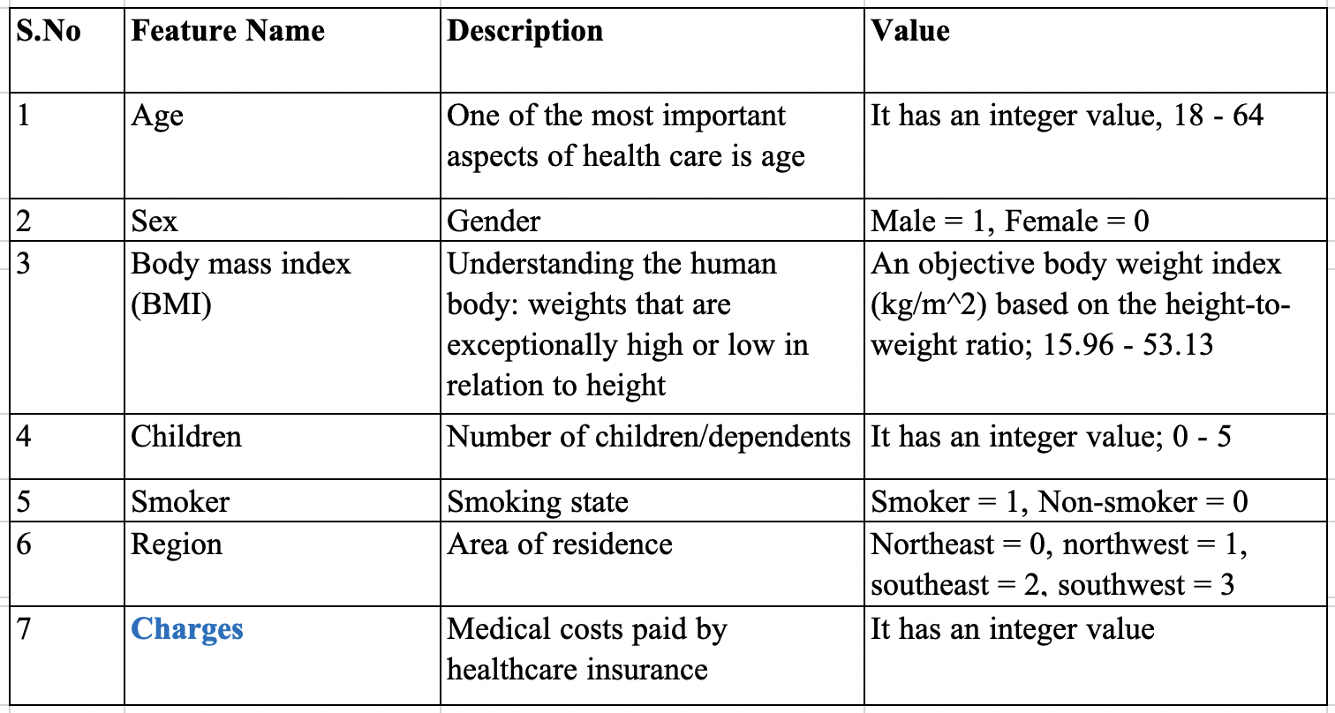
Data Structure
DataSource(CSV-format): https://www.kaggle.com/code/shrutidandagi/medical-insurance-forecast-by-linear-regression/data

Slide 5
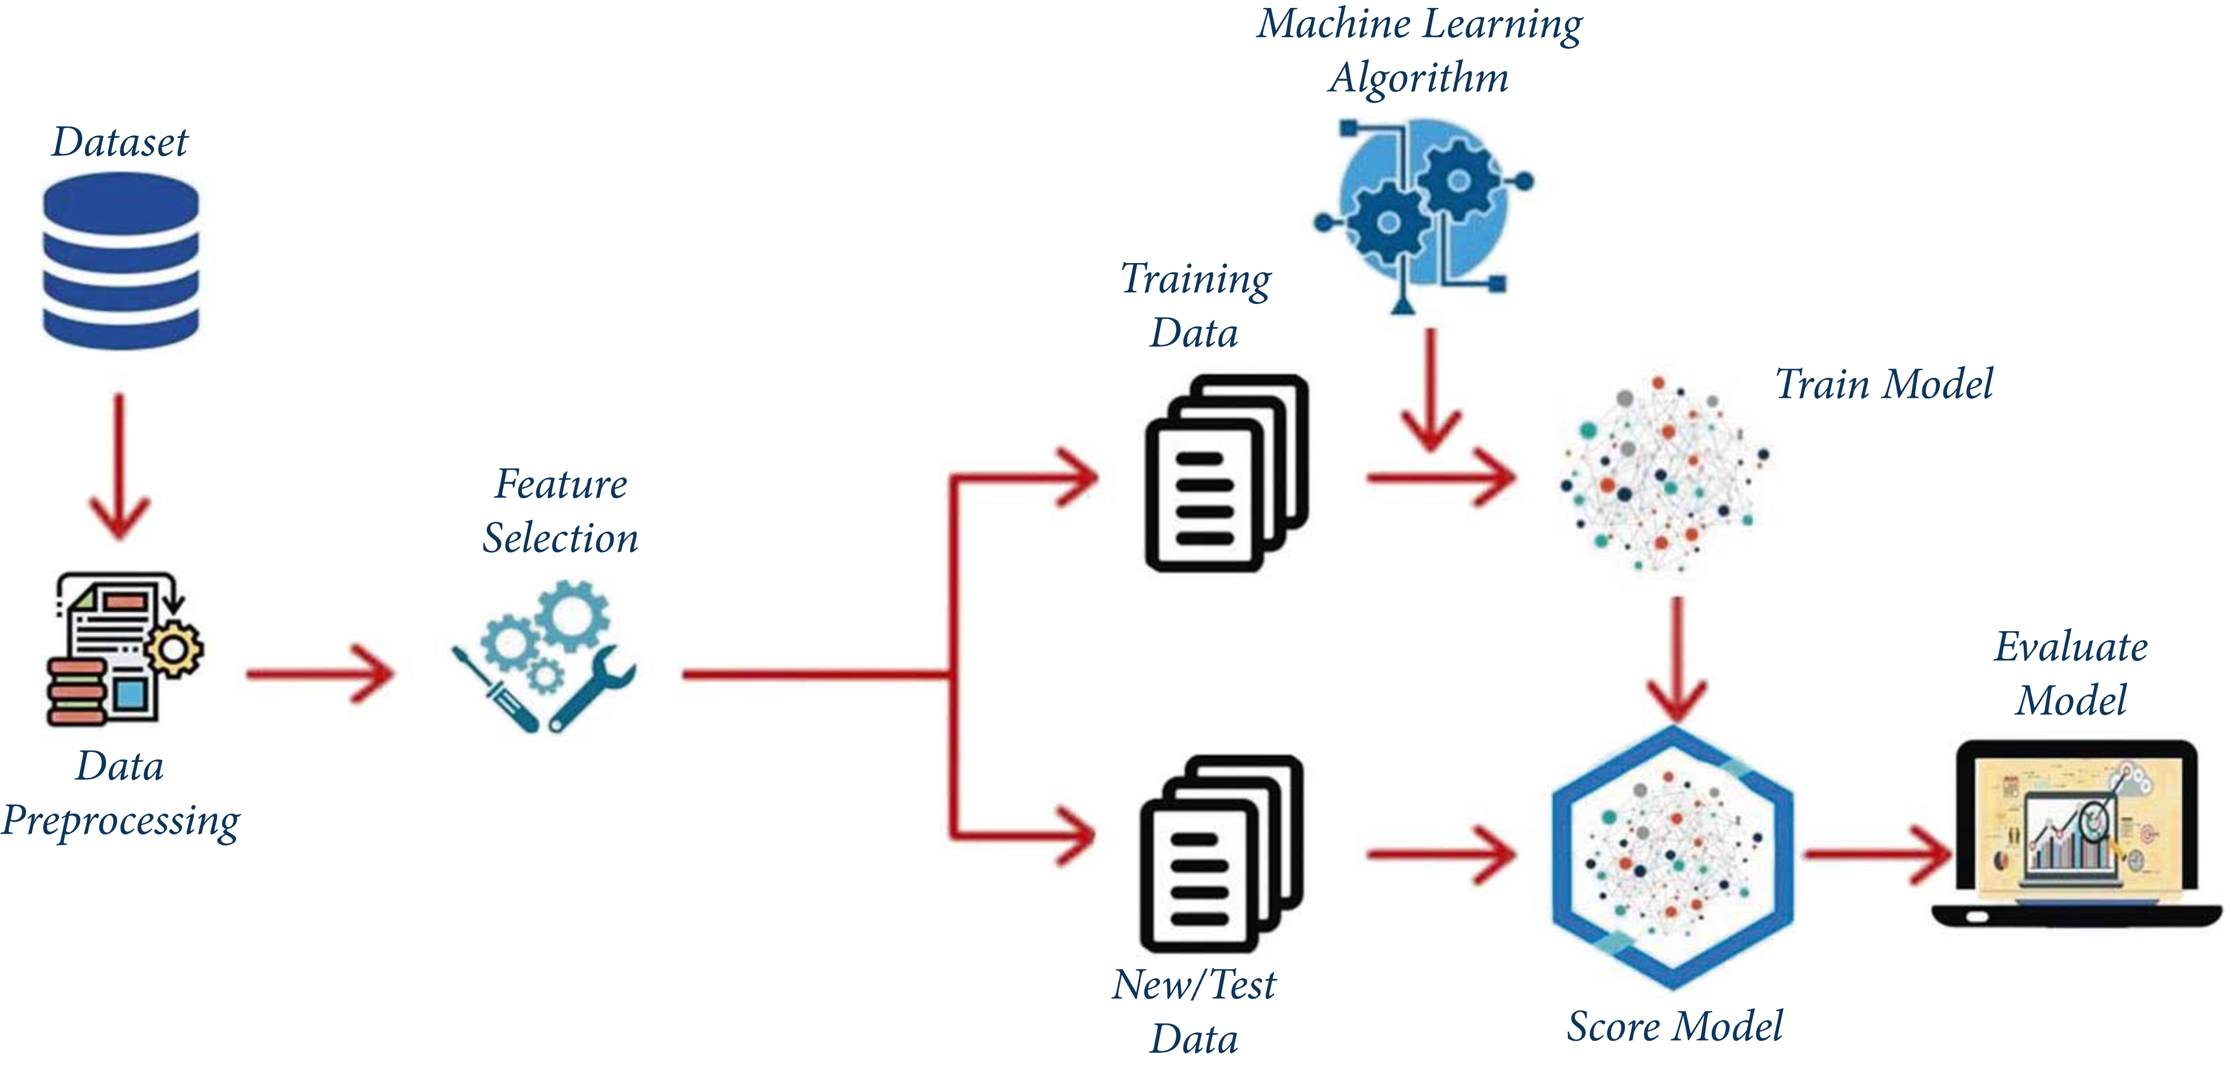
Model Development

Slide 6
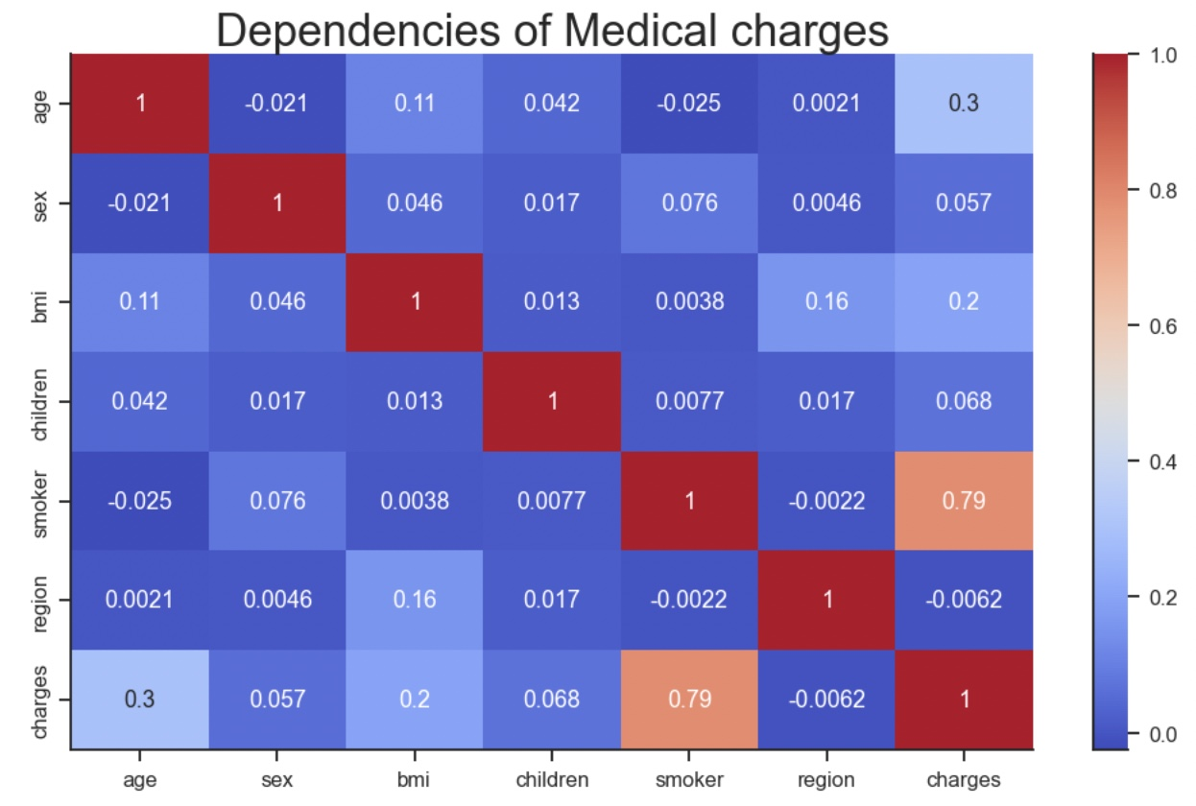
Correlation Matrix
Analysis
Smoker and age affects the charges.
Sex, children, BMI and region do not affect the charges.
dropped the columns that have less correlation.
Correlation Matrix with a heatmap

Slide 7
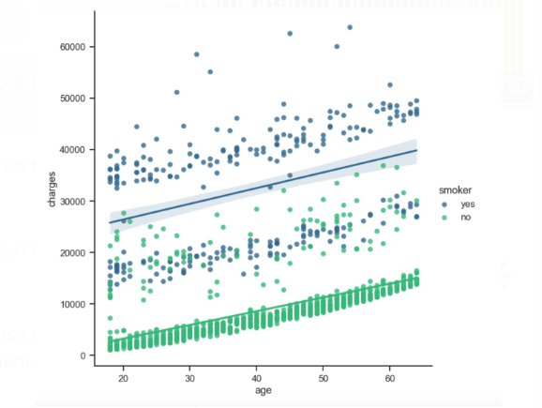
Multiple Linear Regression
yi​ = β0​+β1​xi1​+β2​xi2​+...+βp​xip​+ϵ
y_{i} = dependent variable – charges
x_{i1} = age
x_{i2} = smoker
B1 = regression coefficient that measures a unit change in the dependent variable when xi1 changes - the change in charges when age change
B2 = coefficient value that measures a unit change in the dependent variable when xi2 changes—the change in the charges when smoker change

Slide 8
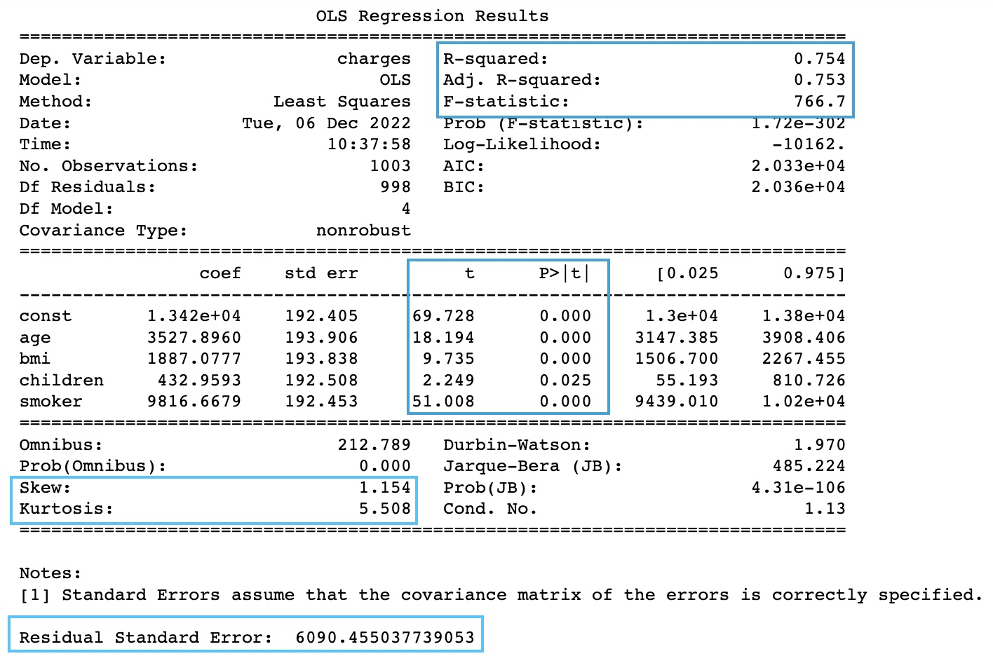
Model Performance
VIF:
age 1.015663
BMI 1.014952
children 1.001065
smoker 1.000494

Slide 9
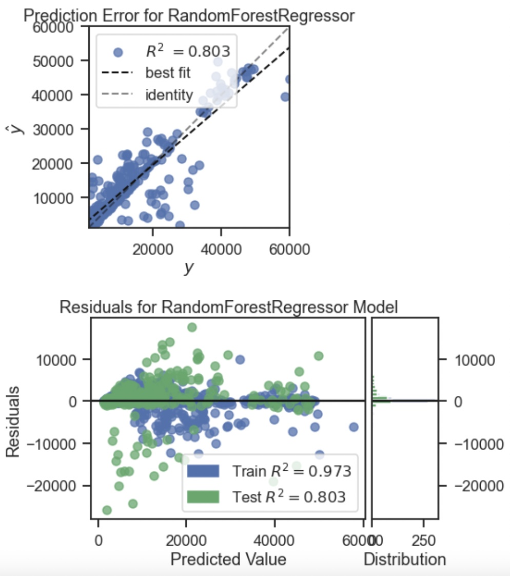
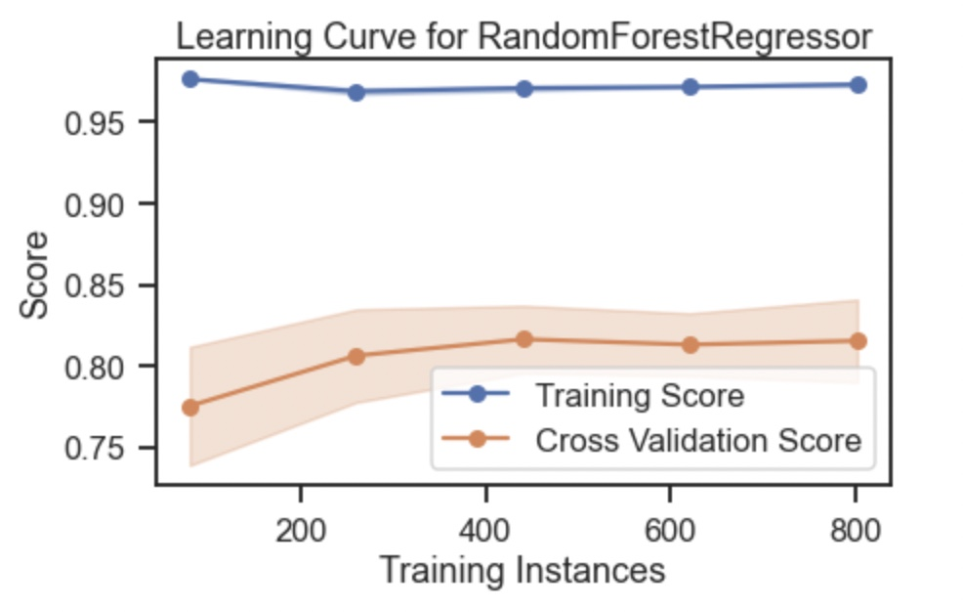
Random Forest Regression

Slide 10
Conclusion:
The regression of this dataset followed the steps of
Preprocessing,
Feature engineering,
Data splitting,
Regression,
Evaluation.
From the regression analysis,
Region, BMI, number of children and gender do not bring signiﬁcant difference on charges.
Age and smoking are the ones that drive the charges.
Smoking seems to have the most inﬂuence on the medical charges.

